Slide 1

MUSIC CONTROL USING WEB APPLICATION
SUPERVISOR & COORDINATOR:
BATCH MEMBERS:
DR G NALINI PRIYA
INFORMATION TECHNOLOGY
Saveetha Engineering College
SV SAI SUPREETH(212219220059)

Slide 2
CONTENTS OF THE PROJECT :
Abstract
Introduction
Proposed Methodology
Architecture Diagram
List of Modules
Module Explanation
Module Implementation
References

Slide 3
ABSTRACT:
Music has been a way for people to reduce their stress and since we all have a variety of emotions, music comes in all type of styles.
Music players allow one to enjoy music in any browser and supports a lot of the features of an offline music player.
We will start by creating the HTML layout first that defines the structure of the player, make it look good by styling using CSS and then write the player logic for all the functions in JavaScript.

Slide 4
INTRODUCTION:
Music is something that we all enjoy in the course of our lives. It is the sound that is brought together through a harmony of instruments and singing voices.
So we are providing “mini music controller” a basic web application with simple UI.
If you want to actually listen to the song you don’t have to browse over the net.

Slide 5
PROBLEM DEFINITION:
Music has been a way for people to reduce their stress and since we all have a variety of emotions, music comes in all type of styles.
It controls music in a way that you can enjoy the sound and song
We will be creating a music player with a clean user interface that can be used to play music in the browser.

Slide 6
PROPOSED SYSTEM:
This project presents music app which gives top songs from all the languages.
This app has a speciality in which songs can be downloaded within the app and we can listen them in offline.

Slide 7
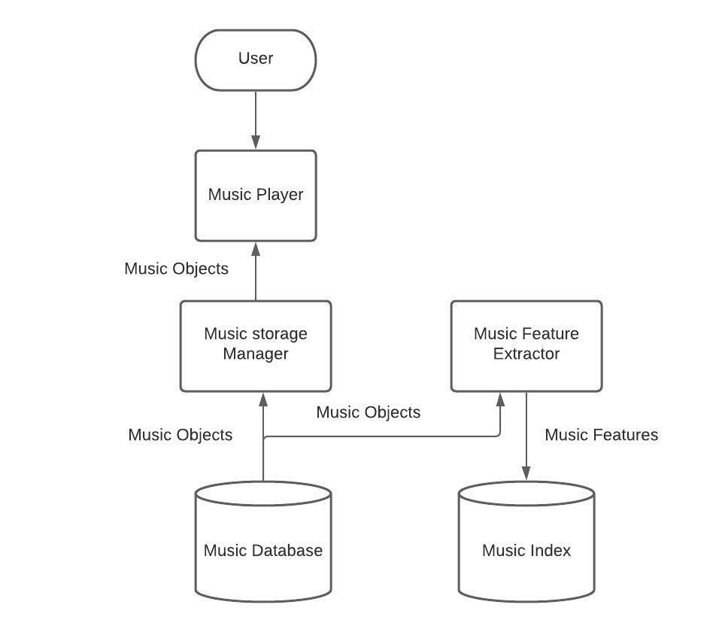
ARCHITECTURE DIAGRAM:

Slide 8
LIST OF MODULES:
Simple audio
Play sound
Material UI
Coding module

Slide 9
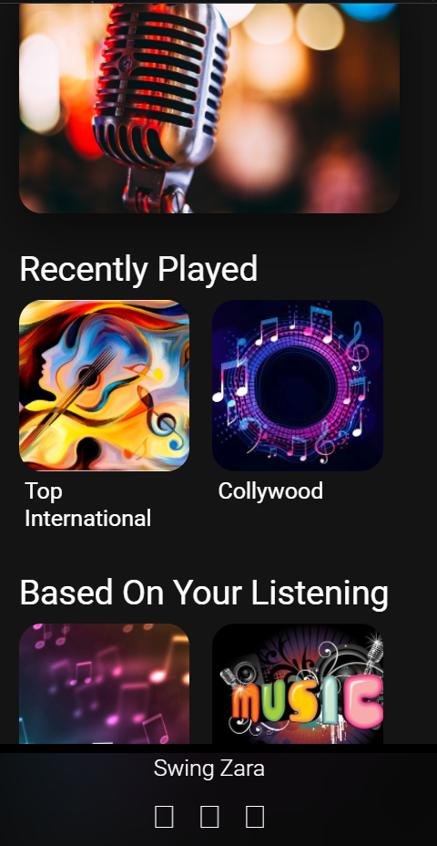
MODULE IMPLEMENTATION:

Slide 10
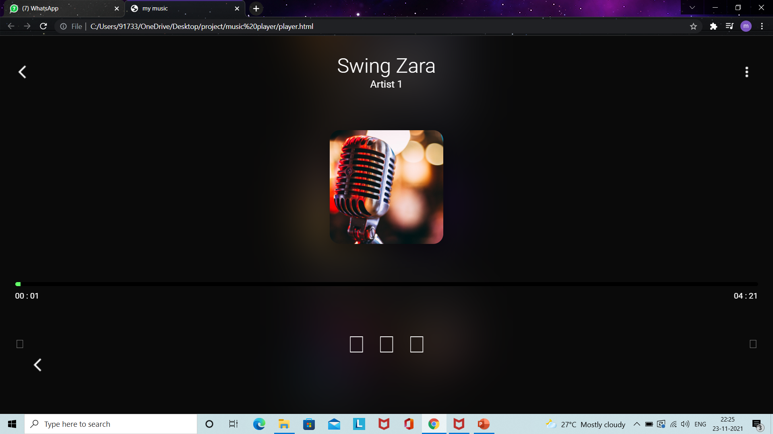

Slide 11
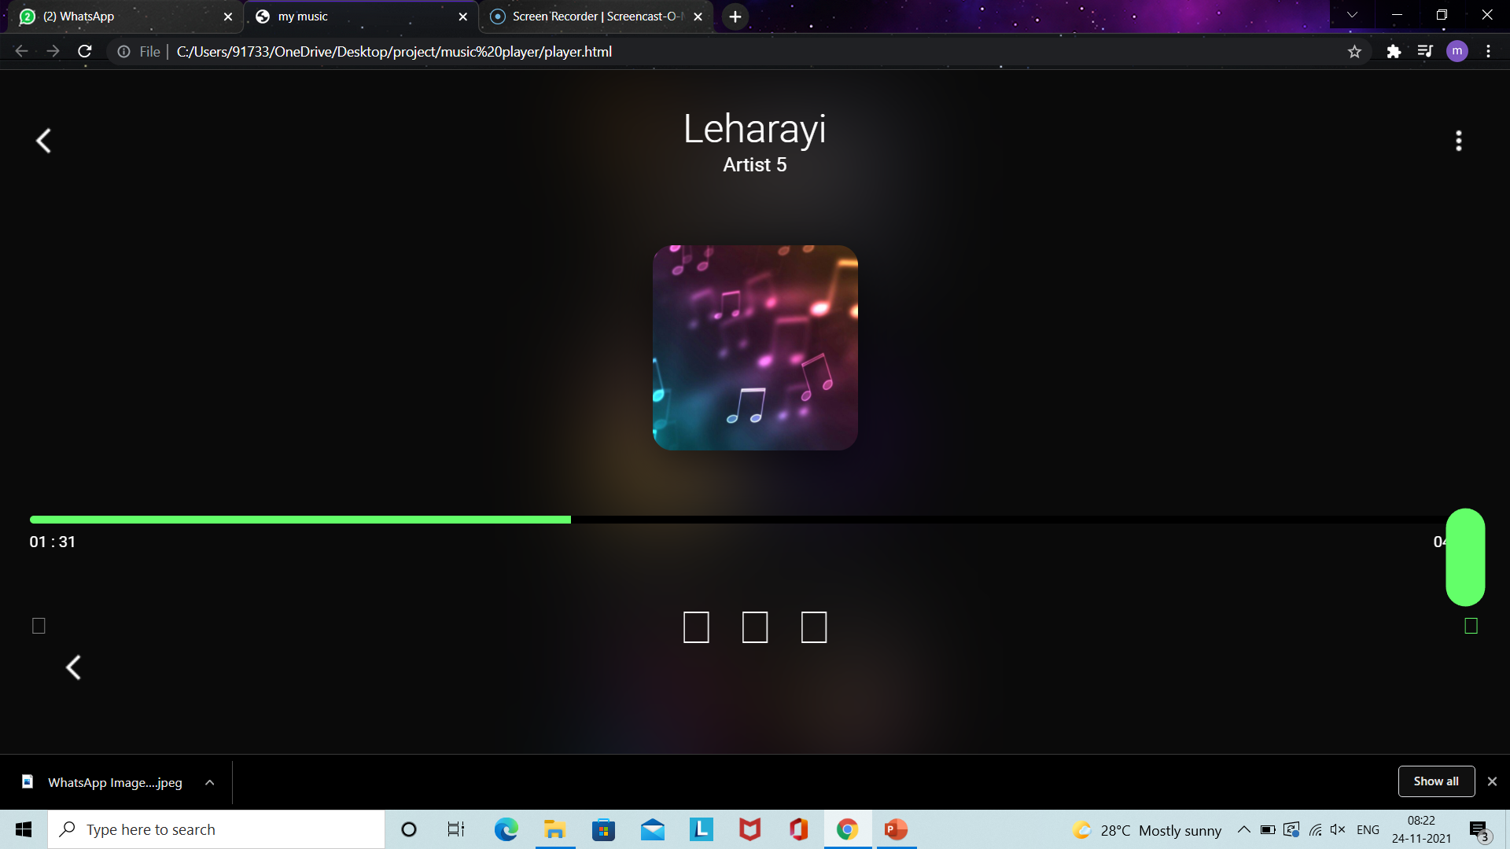

Slide 12
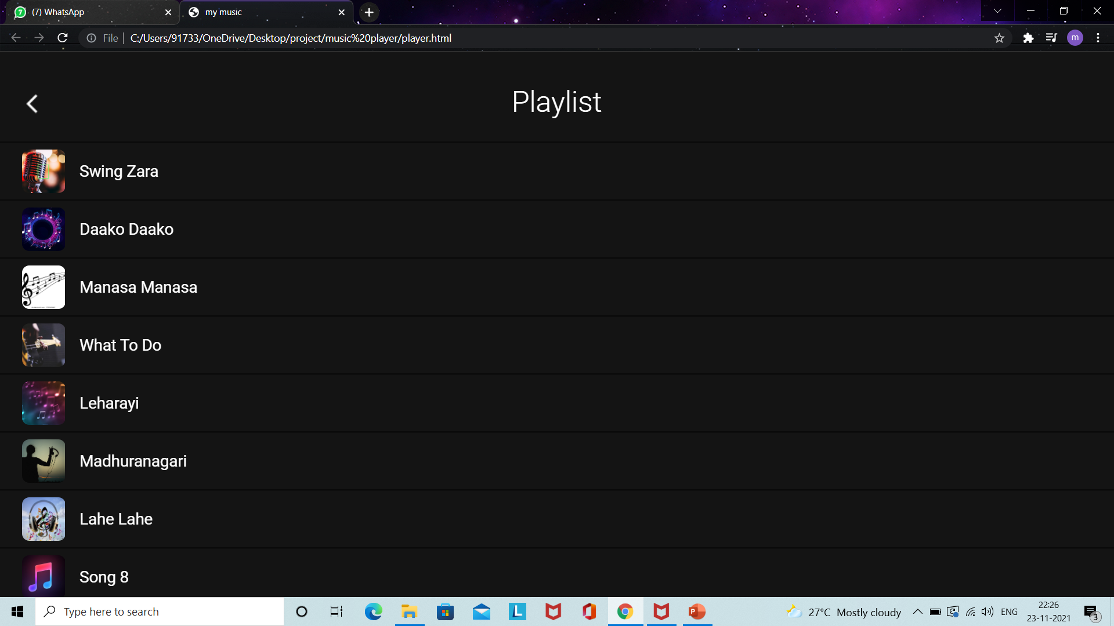

Slide 13
REFERENCES
F . Abdullahi,J .C .Kisha,T Hassan,”Design and Implementation of a web based music portal,” Journal of Applied Informayion system, vol.2 ,no,9,pp.June 2012.
Mathieu Barthet ,Leshao Zhang & Yongmengu,” A Web application for audience participation in live music performance”, International Licence, vol.4, July 11-15 2016.
Jaime Ramirez Castillo& M. Julia Flores,” Web-Based Music Genre Classification for Timeline Song Visualization and Analysis”, Citation information: DOI 10.1109/ACCESS.2021.3053864, IEEE Access.

Slide 14
Thank you

